Slide 1


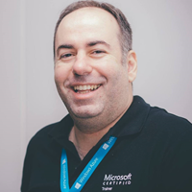


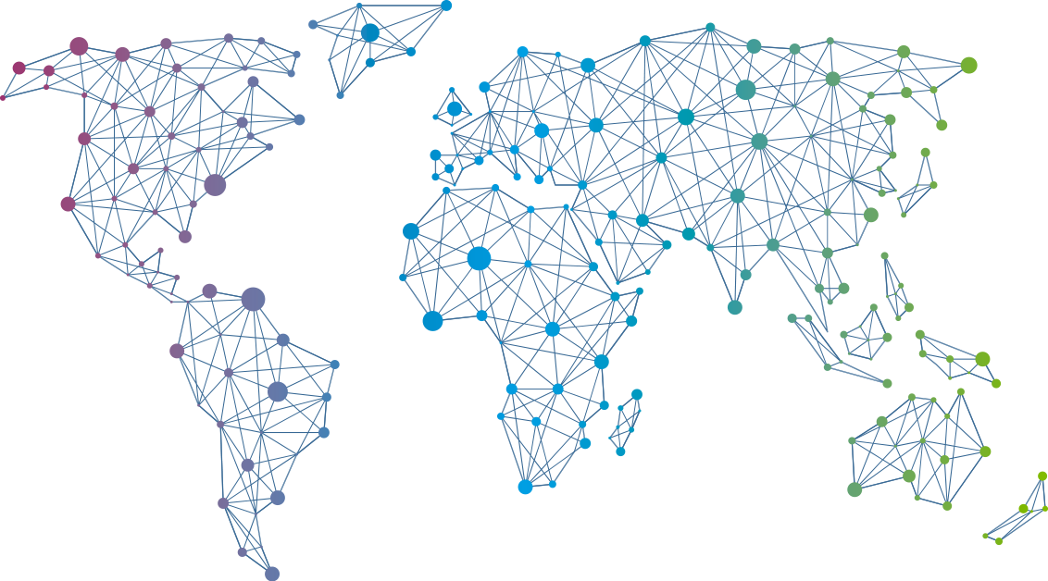

Speaker
André Melancia
Upgrade your grey cells and use Azure Synapse Analytics
André Melancia
AndyPT
September 16th & 17th
^{Online Event}
Powered By
International Conference

